Slide 1
AUTOMATIC MODULATION CLASSIFICATION USING DEEP LEARNING
Ajasra Gupta 19095006
Ayush Kumar Shaw 19095023
Payal Pote 19095074
Supervisor: Dr. Amritanshu Pandey
Associate Professor

Slide 2
OVERVIEW
INTRODUCTION
BACKGROUND
WHY DEEP LEARNING?
DATASET
PROPOSED ARCHITECTURE
RESULT
APPLICATIONS
CONCLUSION
FUTURE WORK

Slide 3
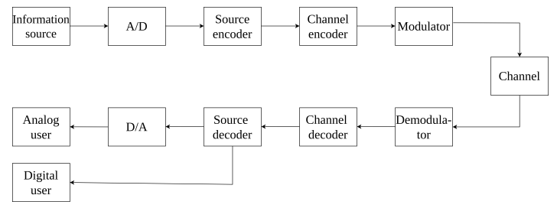
INTRODUCTION
Communication system consists of three basic elements :-
Transmitter Channel Receiver
When a source of information produces a signal containing a message, the transmitter will convert it to a suitable form matching the channel properties. The signal is then propagated over the channel to the receiver, which is located at a different place than the transmitter.

Slide 4
The receiver reconstructs the signal, so that an end-user gets a recognizable form of the original message.
The numerous conditions affecting the channel such as:
fading, Doppler shift, AWGN and many others are challenging for the classifier.
Therefore the key to completing the transmission of the signal and recovering the captured message is a robust, versatile, computationally efficient, and accurate classifier. With deep learning approaches, we can build an end-to-end model for automatic modulation classification which can work efficiently even without any knowledge of the parameters of the signal.
This thesis is focused on radio modulation classification with deep learning architectures. There are two proposed architectures - CNN, CLDNN which are trained and evaluated on a dataset. The main goal was to design architectures with a reduced number of parameters while maintaining high accuracy. The architectures proposed in this thesis have up to 50 times fewer parameters than other often-cited papers .

Slide 5
SOME DEFINITIONS
Additive White Gaussian Noise Channel(AWGN) :
Widely used noise model which is considered to be limitation to accurate modulation
It allows modeling channels with predominant thermal noise.
The channel does not cause fading and the channel only adds the AWGN to the passing signal.
Fading
Fading can be generally categorized as slow and fast.
Slow fading occurs when the transmitted signal is obscured by a large object and can be referred to as shadowing.
The cause of fast fading is interference between multiple versions of the transmitted signal.

Slide 6
BACKGROUND
Previous research work in wireless communication related to modulation recognition is mainly based on signal processing tools for communication , such as cyclostationary feature detection , sometimes combined with traditional machine learning techniques (e.g, decision tree, support vector machine (SVM) , and naive Bayes ).
It turns out that the design of these professional solutions is very time-consuming, because they usually rely on manual extraction of expert features and require a lot of domain knowledge.

Slide 7
To enable a fully automatic feature extraction, several deep neural network- (DNN-) based proposals have been put forward recently, including back propagation (BP) neural network , long short-term Memory (LSTM) and CGDNet.
However, extensive experiments on the open dataset have shown that the recognition accuracy of existing proposals is still unsatisfactory since they cannot fully capture the temporal-spatial characteristics of the signals.

Slide 8
WHY DEEP LEARNING ?
Motivated by the remarkable success of deep learning, especially convolutional neural networks (CNN), the image recognition, speech recognition, machine translation, and other aspects have made great progress.
Wireless communication can also be improved by similar methods to improve the state of the technology in the modulation recognition task and thereby further research in this field is needed.
AMC plays a critical role in understanding the signals transmitted in an interested area in non-cooperative communications .
Traditional modulation recognition algorithms, including maximum likelihood hypothesis and statistical pattern recognition, are labor-intensive in their feature extraction process, and their recognition accuracy severely relies on the prior knowledge about the signals .
Notes:
Motivated by the remarkable success of deep learning in various fields we have used this approach to solve the problem of modulation classification. What is different about this approach is that the input signal can be directly passed to a DL model for classification. It can work without any feature extraction, and it does not need to know anything about the parameters of the signal. The classifier can include a huge number of modulations without any significant increase in computational complexity. The most common type of neural networks used for modulation classification are Convolutional or Recurrent neural networks.

Slide 9
The accuracy and robustness of these two types of methods can be extremely low when limited or non-representative features are adopted for recognition.
Recently, DNN-based AMC has been popular due to their unique capability for automatic feature extraction as mentioned above, but their accuracy and latency is still unsatisfactory when applying to complicated and diversified modulation modes.
To promote the recognition accuracy and the computation efficiency, we developed and trained a framework utilizing CNN and CLDNN as the pattern-digger and multilevel attention to select the salient feature for classifying different modulation modes.
The inphase and quadrature-phase (IQ) data of modulated signal is intended as a two-dimensional image and is adopted as the input data.
Existing efforts usually classify different modulation modes through extracting the spatial or temporal features from the input IQ data. However, experimental results have shown that relying solely on the features in one domain could not achieve high accuracy. This motivates us to develop our hybrid DNN framework.

Slide 10
DATASET
RadioML Dataset
Created with GNU Radio software and are synthetic
Represented as 2x128 vectors of in-phase and quadrature signals.
SNR ratios ranging from -20 dB to 18 dB
Consist if 220,000 signal samples modulated using 8 digital and 3 analog modulation schemes
BPSK(digital) CPFSK (digital) WBFM (analog)
QPSK(digital) GFSK (digital)
8PSK (digital) PAM4 (digital)
QAM16 (digital) AM-DSB (analog)
QAM64 (digital) AM-SSB (analog)

Slide 11
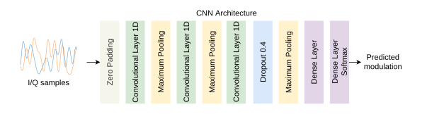
PROPOSED ARCHITECTURES
CNN:
Uses three 1D convolutional layers
Layers are activated by ReLU ( provide a non-linearity to the layers)
Maximum pooling layers down-samples the length of the sequence
A dropout layer is added to prevent overfitting
Last dense layer activated by Softmax activation function
The overall number of parameters is 73,730

Slide 12
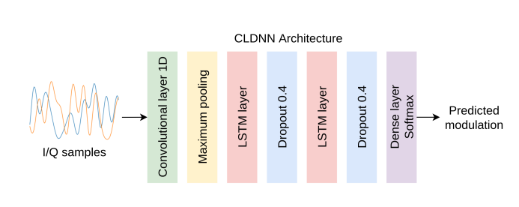
2. CLDNN:
Architecture consist of convolutional layers and maximum pooling layer followed by 2 LSTM layers.
LSTM Layer:
Long Short Term Memory networks are special kind of RNN
They are capable of learning long-term dependencies

Slide 13
Also 2 dropout layers are added along with LSTM layers.
The final layer is again a dense layer activated with a Softmax function
This architecture resulted in 105,546 parameters

Slide 14
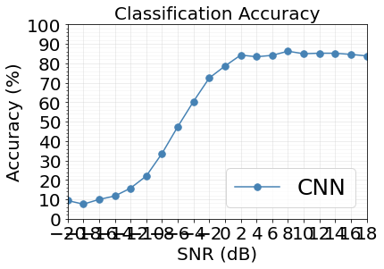
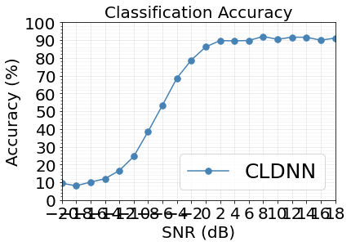
Experiments and Results
Notes:
Training Details: LR, Reduce LR on Plateau, Adam, Batch size

Slide 15
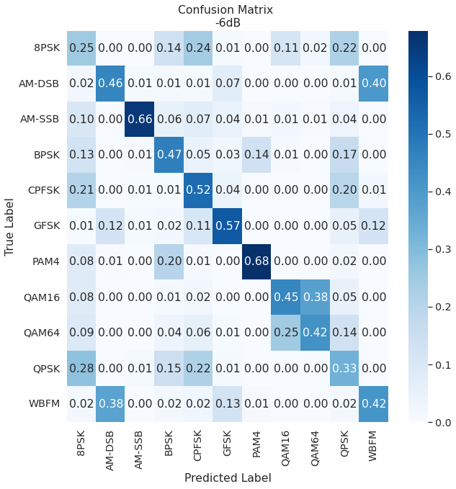
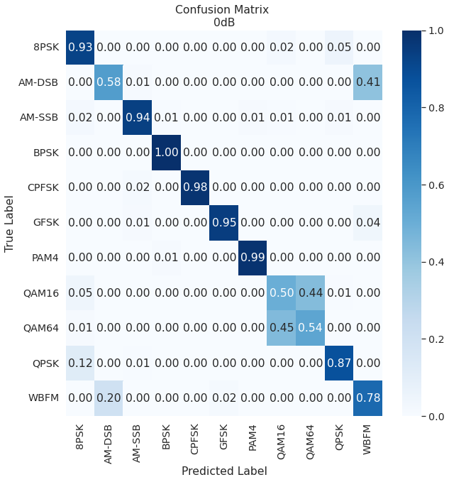
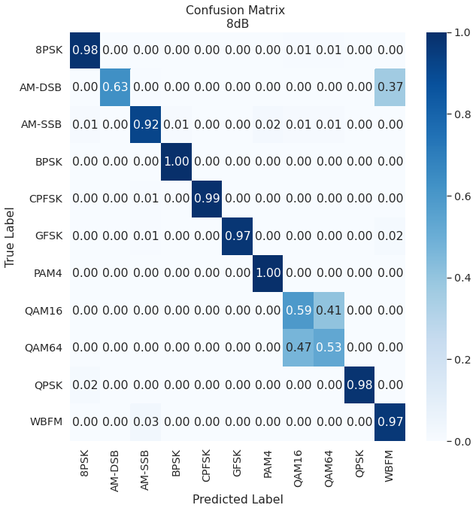
Confusion Matrices (CNN)
Notes:
Explain what is a confusion matrix
Why are QAMs so difficult to tell apart?

Slide 16
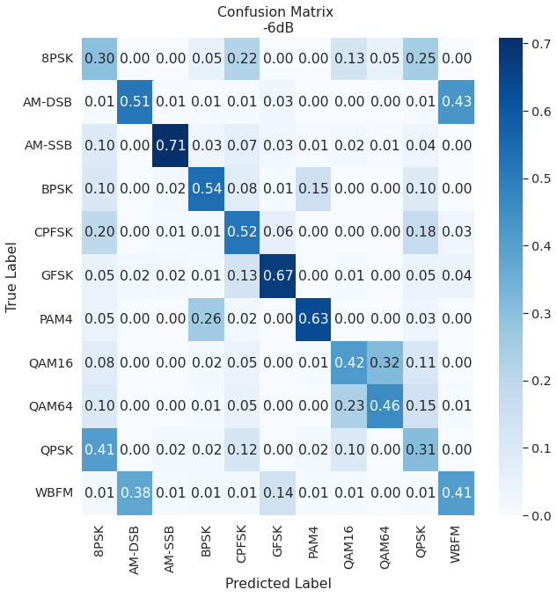
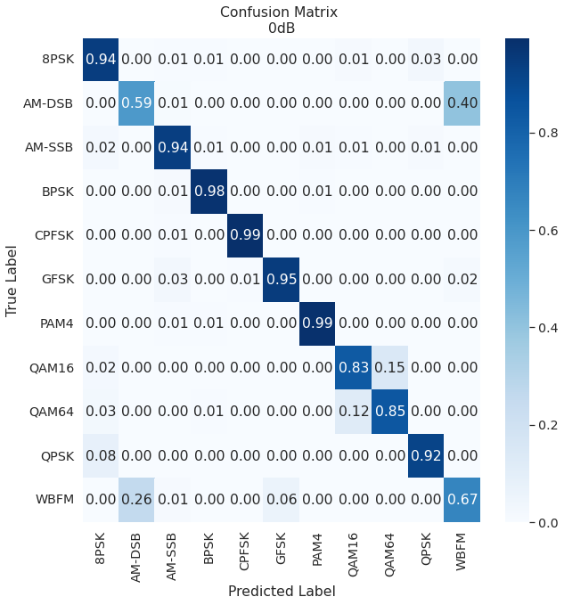
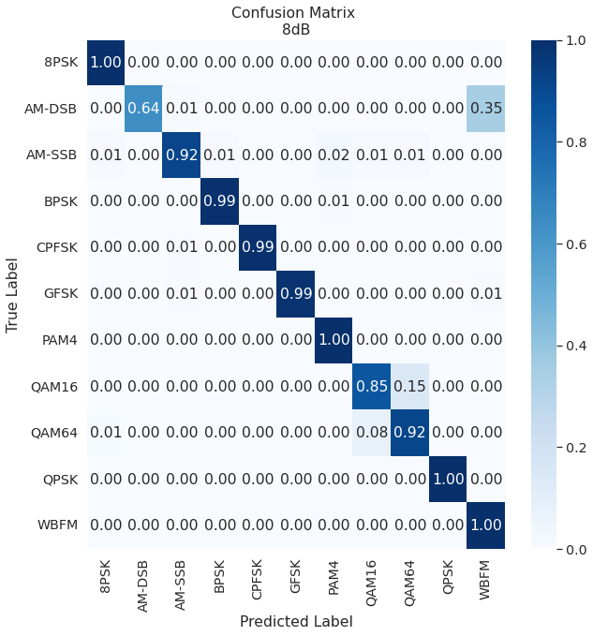
Confusion Matrices (CLDNN)

Slide 17
Applications
AMC plays an important role in may civil and military applications such as cognitive radio and adaptive communication.
AMC has several applications in the upcoming 5g technology.
Notes:
Cognitive radio is a form of wireless communication in which a transceiver can intelligently detect which communication channels are in use and which are not.

Slide 18
Conclusion
Deep Learning is a potential approach to Automatic Modulation Classification. It has a bunch of advantages over the classical methods used for modulation recognition.
Our model uses a very small number of parameters and still achieves classification accuracies as high as 92%. Hence, we deploy such light weight models in any embedded systems for detecting the type of modulation schemes used in various received signals, before demodulation.

Slide 19
References
Automatic Modulation Classification Based on Deep Learning for Software-Defined Radio
Machine Learning remakes radio
A Comparative Study between CNN, LSTM, and CLDNN Models in The Context of Radio Modulation Classification
A Survey of Automatic Modulation Classification Techniques: Classical Approaches and New Trends Communications
Fast Deep Learning for Automatic Modulation Classification
Deep Neural Network Architectures for Modulation Classification
Radio Modulation Classification Using Deep Learning Architectures

Slide 20
THANK YOU

